Slide 1

Play Based Learning Activities

Slide 2


Empowering Mankind
MySkill - Empowering womanhood, is program with a vision to give a platform to all the women for diversifying their existing skills to meet today's challenges. MySkill aims at building actual competencies to achieve their highest desired level of independence and inclusion in their communities.
MySkill has partnered with institutes who have a proven track record of training and empowering women through various educational and experiential learning in the past.
MySkill offers a platform for all aspiring women who want to have a greater expansion in professional and personal growth which in turn contribute to structural transformation and economic growth by enhancing employability.

Slide 3

Agenda
Nature Exploration Games
Math and Shape Activities
Science Exploration
Art and Creativity
Language and Literacy Games
Physical Activities
Social Skills Activities
Reflection and Discussion
Nature Theme
Colors Theme
Music and Movement Theme
Seasons Theme
Healthy Living Theme
Conclusion
Craft Making Activity
Action Rhymes
Word Puzzle Activity

Slide 4

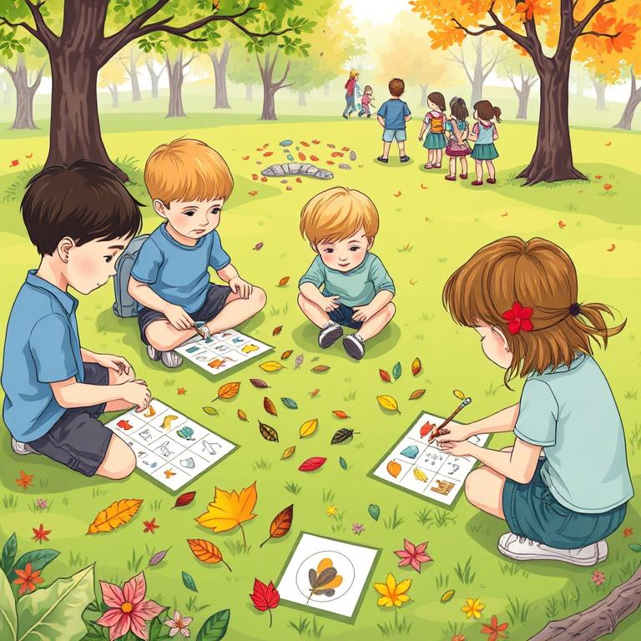

Nature Exploration Games
Examples of Nature Exploration Games
Nature Bingo: Create bingo cards with pictures of common outdoor items (e.g., leaves, flowers, insects). As children explore a garden or park, they can mark off items they find, encouraging observation and interaction with nature.
Sensory Nature Walk: Go on a walk where children are encouraged to touch, smell, and listen to their surroundings. Provide a checklist of sensory experiences (e.g., 'Find something smooth,' 'Listen for birds') to enhance engagement.
These games facilitate learning through exploration for children aged 3 to 6 years, allowing them to discover concepts through play.
Plus tip:
Consider customizing the bingo cards with local flora and fauna to make the activity more relevant to your area. Encourage children to share their findings during the sensory walk to enhance social interaction.

Slide 5
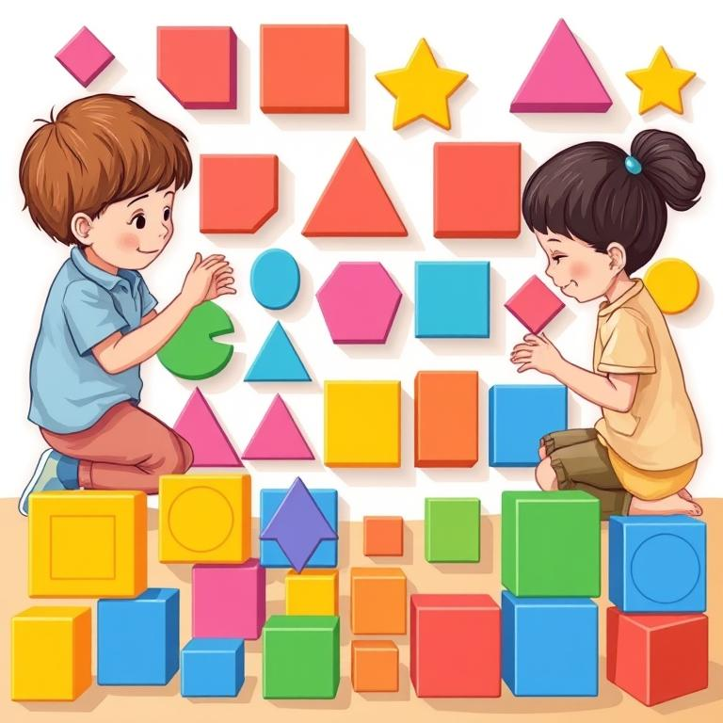

Math and Shape Activities
Math-Related Play Activities for Young Children
Shape Hunt involves hiding various shapes around the classroom or play area. Children receive a checklist of shapes to find and discuss their properties as they discover them, enhancing shape recognition.
Counting with Blocks uses colorful building blocks to create a counting game. Children build towers while counting the blocks, reinforcing number recognition and fine motor skills.
Both activities encourage active engagement and exploration, allowing children to learn mathematical concepts through play.
These hands-on experiences not only make learning fun but also help children develop critical thinking and problem-solving skills.

Slide 6
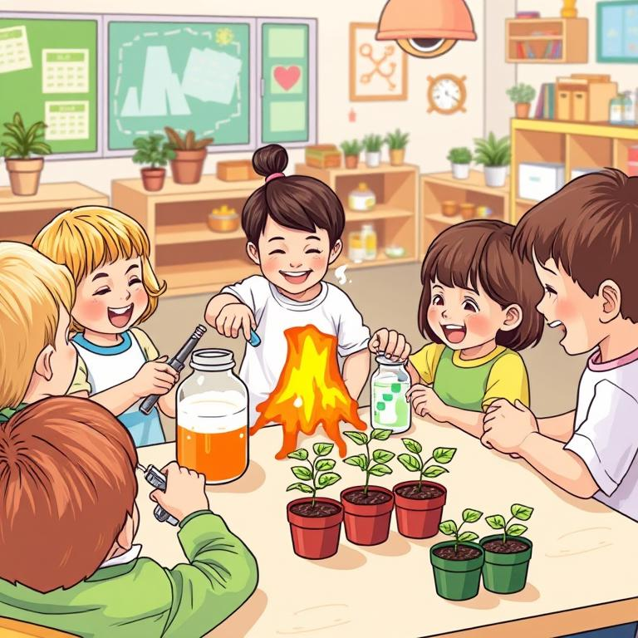
Science Exploration
Science Activities for Young Children
Conduct simple science experiments, such as mixing baking soda and vinegar to create a volcano, allowing children to predict outcomes and discuss results together.
Provide seeds and small pots for children to plant, encouraging them to water their plants and observe changes over time, discussing growth stages and plant needs.
Encourage children to explore the properties of various materials through hands-on activities, fostering curiosity and scientific thinking.
Discuss the importance of observation in science by having children keep a journal of their experiments and plant growth, enhancing their language and literacy skills.

Slide 7
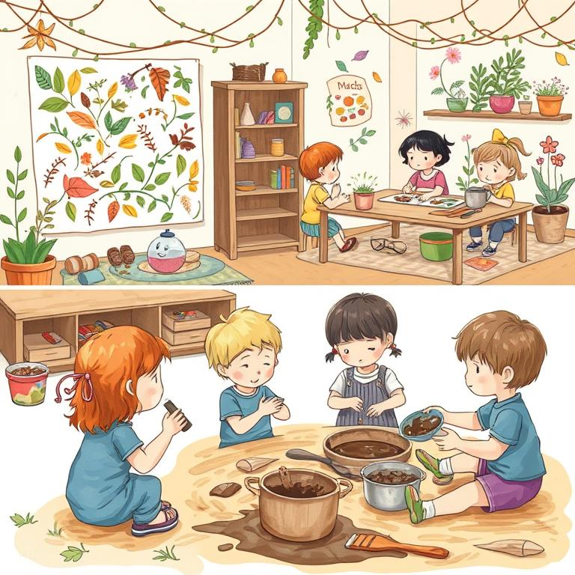
Art and Creativity
Plus tip:
Consider incorporating various natural materials to enhance the nature collage activity. You can also introduce themes or stories that relate to the mud kitchen play, encouraging deeper engagement.
Activities to Encourage Creativity
Nature Collage: Collect natural materials (leaves, twigs, flowers) and provide glue and paper for children to create a collage. This encourages creativity while exploring textures and colors.
Mud Kitchen: Set up a designated area with pots, pans, and utensils for children to 'cook' with mud and natural materials. This promotes imaginative play and sensory exploration.
Encourage children to discuss the different textures and colors they are using in their collages, fostering language development alongside creativity.
In the mud kitchen, introduce concepts of measurement and mixing, allowing children to experiment with different ratios of mud and water, enhancing their understanding of basic science principles.

Slide 8
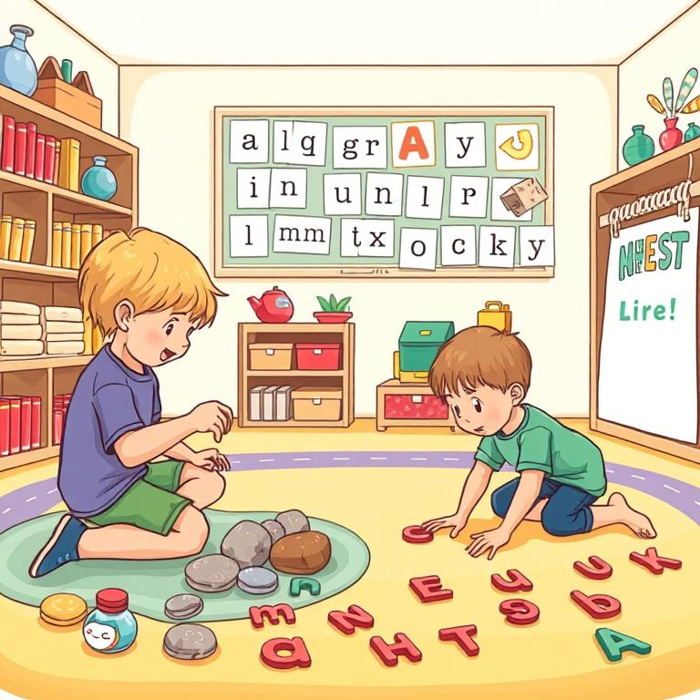
Language and Literacy Games
Enhancing Language and Literacy Skills
Story Stones involve painting stones with images that represent different story elements such as characters, settings, and objects. Children can use these stones to create and tell their own stories, enhancing creativity and narrative skills.
Letter Treasure Hunt is an engaging activity where letters are hidden around the room. As children find them, they are encouraged to identify the letter and say its sound, reinforcing letter recognition and phonics. This interactive approach supports language development while making learning enjoyable.
Both activities promote active participation, allowing children to explore language in a fun and creative manner. Through storytelling and letter recognition, children develop essential literacy skills that are foundational for their educational journey.

Slide 9
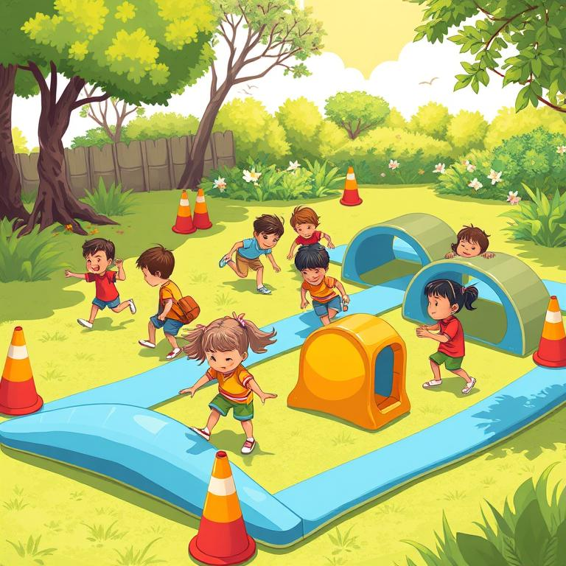
Physical Activities
Enhancing Motor Skills and Body Awareness
Create an obstacle course using soft play equipment, cones, and tunnels. Children can practice gross motor skills while navigating the course, which also promotes teamwork and problem-solving.
Incorporate games like 'Simon Says' or 'Freeze Dance' to encourage listening skills and body awareness. These games can also be tailored to incorporate concepts like shapes, colors, or animal movements.
Encourage children to participate in relay races that require running, jumping, and crawling, enhancing their physical coordination and teamwork skills.
Introduce rhythmic movement activities where children can dance to music, promoting body awareness and rhythm while having fun.

Slide 10
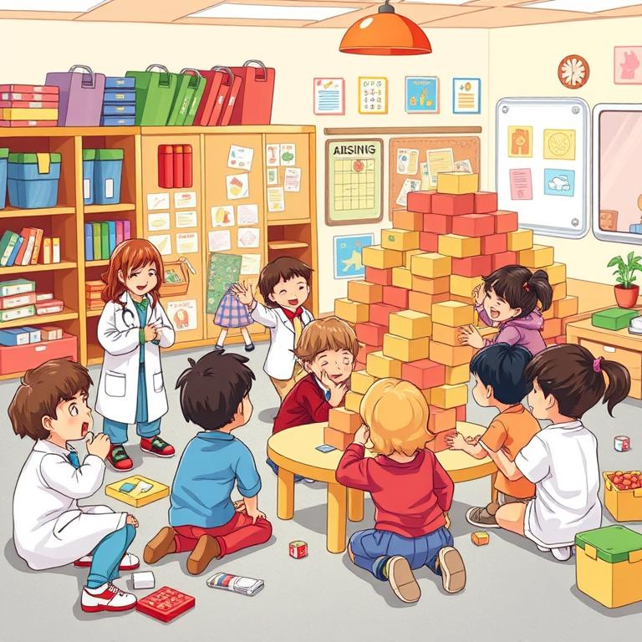
Social Skills Activities
Plus tip:
Consider tailoring role play scenarios to reflect real-life situations that resonate with the children's experiences. This will make the activities more relatable and impactful.
Developing Social Interaction and Communication Skills
Role Play Scenarios allow children to engage in imaginative play, such as a grocery store or doctor's office. This fosters social interaction and communication skills as they navigate various roles and situations.
Cooperative Building encourages children to work together to construct a structure using blocks or large materials. This activity promotes collaboration, negotiation, and sharing, essential components of social skills development.
Both activities create a rich environment for children to practice their language skills as they express ideas, negotiate roles, and communicate their thoughts with peers.
These engaging play-based activities not only enhance social skills but also build confidence and creativity among young learners.

Slide 11
Art and Creativity
Plus tip:
Consider incorporating various natural materials to enhance the nature collage activity. You can also introduce themes or stories that relate to the mud kitchen play, encouraging deeper engagement.
Activities to Encourage Creativity
Nature Collage: Collect natural materials (leaves, twigs, flowers) and provide glue and paper for children to create a collage. This encourages creativity while exploring textures and colors.
Mud Kitchen: Set up a designated area with pots, pans, and utensils for children to 'cook' with mud and natural materials. This promotes imaginative play and sensory exploration.
Encourage children to discuss the different textures and colors they are using in their collages, fostering language development alongside creativity.
In the mud kitchen, introduce concepts of measurement and mixing, allowing children to experiment with different ratios of mud and water, enhancing their understanding of basic science principles.

Slide 12
Reflection and Discussion
Reflection and discussion after activities are crucial for reinforcing learning concepts. Gathering the children to share their experiences encourages them to articulate what they learned and how they felt about the activities. Open-ended questions can be posed to facilitate this discussion, allowing children to express their thoughts, fostering language development and critical thinking skills.
Plus tip:
Consider tailoring your questions to the specific activities conducted to enhance engagement and relevance.

Slide 13
Nature Theme
Subjects Connected: Science, Art, Language, Music
Take the children on a nature walk to collect leaves, flowers, and small twigs.
Back in the classroom, they can use these items to create nature collages.
Discuss the different plants they found, encouraging vocabulary development related to nature.
Teach children songs that celebrate nature (e.g., 'The Green Grass Grows All Around').
Use hand motions to represent various elements (like trees, flowers, and animals) to incorporate movement into the lesson.
Engagement through Nature Activities
Introduce various animals found in nature and play recordings of their sounds.
Have children mimic animal sounds, connecting language skills and auditory discrimination.
Encourage creativity by discussing the origins and cultural significance of the instruments used during music activities.
Plus tip:
Consider adding images of children engaging in nature activities or examples of nature collages to enhance visual appeal.

Slide 14
Colors Theme
Subjects Connected: Art, Math, Language, Science
Provide primary colors of paint for mixing new colors, integrating art and science.
Organize a scavenger hunt for different colors around the classroom or playground, categorizing objects to tie into math.
Read books emphasizing colors, like 'Brown Bear, Brown Bear, What Do You See?', discussing favorite objects in those colors.
Activities Overview
Color Mixing Exploration helps children understand color theory and fosters creativity.
Color Scavenger Hunt promotes categorization and sorting skills, enhancing math understanding.
Story-time with Colors develops language skills and comprehension through interactive reading.

Slide 15
Music and Movement Theme
Subjects Connected: Music, Physical Education, Language, Social Studies
Provide a variety of instruments (shakers, drums, xylophones) for sound exploration.
Discuss the instruments' origins and cultural significance as children make sounds.
Encourage children to move in different ways (e.g., tiptoe, jump, sway) to music.
Introduce concepts of tempo and rhythm through movement games like Freeze Dance.
Create a short dance that tells a story, integrating language and creativity.
Activities and Engagement
Allow children to explore making sounds and rhythms with various instruments.
Incorporate movement into lessons using songs that celebrate nature.
Encourage mimicry of animal sounds to connect auditory skills and wildlife understanding.
Foster social interaction through group dance activities that tell a story.
Engage children in discussions about their favorite movements and music.
Plus tip:
Consider adding specific songs or instruments that are popular with children to make the activities more relatable.

Slide 16
Seasons Theme
Subjects Connected: Science, Art, Language, Math
Create crafts that represent different seasons.
For example, make snowflakes for winter, flowers for spring, leaves for autumn, and sun for summer.
Discuss the characteristics of each season during crafting sessions.
Create a daily weather chart where children can observe and mark the weather.
Seasonal Learning Activities
Engage in discussions about seasonal changes and associated weather patterns.
Integrate art by using seasonal themes in storytelling and craft-making.
Encourage children to observe nature and describe seasonal changes, enhancing vocabulary.
Incorporate tallying and counting based on the weather chart, connecting to math.

Slide 17
Healthy Living Theme
Subjects Connected: Science, Health, Art, Language
Create art using pictures of healthy foods, discussing benefits of fruits and vegetables.
Introduce simple exercises or yoga poses that promote physical health, integrating math and science.
Read books about healthy living, engaging children in discussions about their favorite healthy foods.
Activity Ideas
Healthy Food Art: Have children create art using pictures of healthy foods.
Movement Activities: Introduce simple exercises or yoga poses that promote physical health.
Story-time on Healthy Habits: Read books about healthy living, like 'Eating the Alphabet'.

Slide 18
Conclusion
Incorporating games and hands-on activities allows children aged 3 to 6 to learn through exploration and play. These methods foster curiosity, creativity, and critical thinking while supporting their overall development. By enacting themed lessons that connect various subjects, educators can create a rich, holistic learning experience. Tailoring activities to children's interests and developmental stages ensures that learning is both fun and meaningful, ultimately enhancing their educational journey.
Plus tip:
Consider adding specific examples of how these methodologies have positively impacted children's learning and engagement.

Slide 19
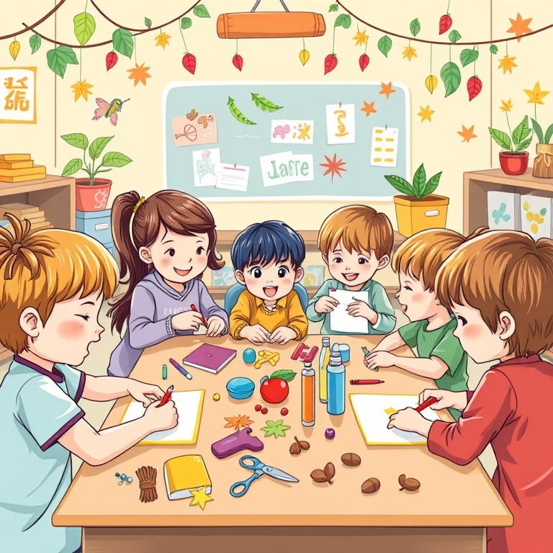
Craft Making Activity
Theme-Based Craft Creation
Children are encouraged to choose any theme they are interested in, such as nature, colors, or seasons, to guide their craft-making activities.
Using relevant materials, they can create unique crafts that reflect their chosen theme, fostering creativity and personal expression.
This hands-on experience enhances thematic understanding as children discuss the significance of their crafts and the themes they represent.
Plus tip:
Customize this slide by suggesting specific themes relevant to your audience, or by adding examples of crafts that can be made for each theme.

Slide 20
Action Rhymes
Singing action rhymes engages children physically and cognitively, allowing them to learn through movement.
These rhymes can be adapted to various themes, making them relevant and enjoyable for young learners.
Incorporating hand motions or movements related to the lyrics fosters physical coordination and enhances memory retention.
Plus tip:
Consider choosing themes that align with the current curriculum or seasonal events to make the activity more engaging for the children.

Slide 21
Word Puzzle Activity
Organize children into teams of two to foster collaboration and communication.
Provide each team with a word puzzle that they need to solve together, enhancing their problem-solving skills.
Encourage teams to create their own word puzzles to challenge other teams, promoting creativity and language development.
Plus tip:
Consider varying the difficulty of the word puzzles based on the children's language skills. This activity can be adapted for different themes to keep it engaging.

Slide 22

MySkool is an inspiration for schools, teachers, parents and students to excel in life. It is a message that ‘good is always appreciated.’ It is a push towards self motivation, an opportunity to see how others are growing and a chance to appreciate fellow human beings.

